Slide 1
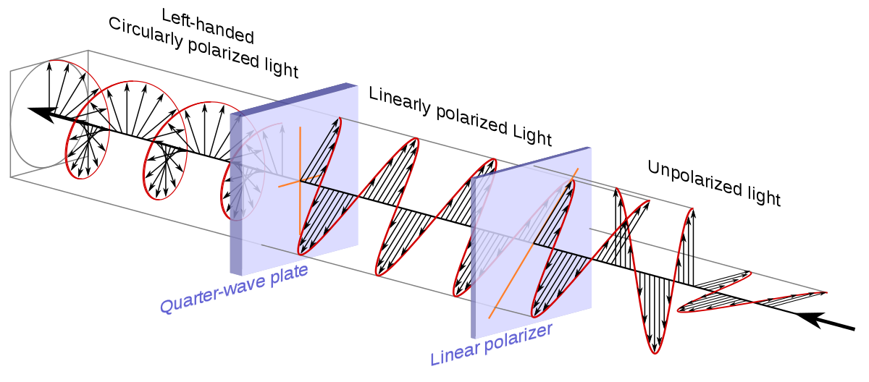
Polarization in spectral lines
Július Koza
Astronomical Institute, Slovak Academy of Sciences
Tatranská Lomnica, Slovakia

Slide 2
Reference book monograph on theory of polarization in spectral lines
Egidio Landi degl’Innocenti, Marco Landolfi:
Polarization in spectral lines, Volume I and II
(Springer, 2004)

Slide 3
Natural or unpolarized light
an excited atom radiates a photon for roughly 10⁻⁸ s
a photon = a wave train
a beam of natural (unpolarized) light = a large number of wave trains with randomly-oriented oscillation planes of their electric vectors

Slide 4
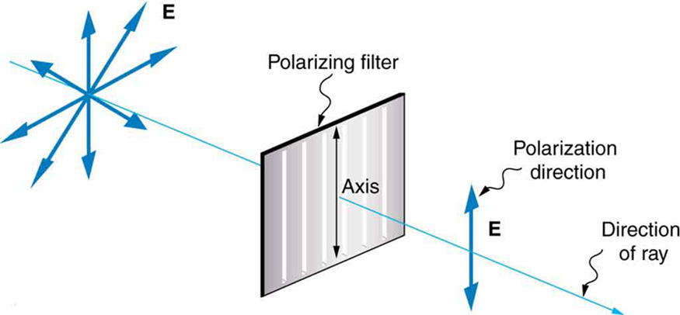
What we mean by “polarization”
Polarization = an existence of a spatial alignment of wave oscillation planes in a light beam
or in other words
= an existence of a preferred direction of oscillation of electric vectors of light waves in a beam

Slide 5
Methods of achieving polarization
Polarization is a result of an asymmetry in an optical process
or in other words an anisotropy in properties of a medium
Basic processes generating polarization:
reflection
scattering
birefringence
dichroism (or selective absorption)

Slide 6
Polarization ellipse

Slide 7
Polarization ellipse
Eliminating ωt dependence in above equations one can obtain:
Equation of Ellipse

Slide 8
Polarization ellipse
In most general case the tip of electric vector describes an ellipse.
The ellipse can be represented as a superposition of two perpendicular plane waves E_{x} and E_{y} with a non-zero phase difference δ.

Slide 9
Visualization of the polarization ellipse
http://emanim.szialab.org/

Slide 10
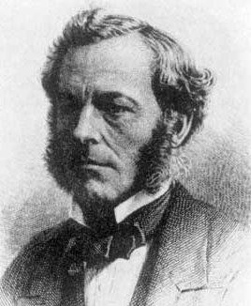
From the polarization ellipse
to the Stokes parameters I, Q, U, V
G. G. Stokes, “On the Composition and Resolution of Streams of Polarized Light from different Sources”
Trans. Cambridge Phil. Soc., Vol.9, 1852, pp.399-416
George Gabriel Stokes
1819-1903
The equation of polarization ellipse:
All the information about polarization is contained in this equation.

Slide 11
From the polarization ellipse
to the Stokes parameters I, Q, U, V
George Gabriel Stokes
1819-1903
In order to observe the quantities involved let take the time average <...> of the time dependent quantities in the Polarization Ellipse equation.
where

Slide 12
From the polarization ellipse
to the Stokes parameters I, Q, U, V
We obtain
By adding and subtracting on the left side of this equation we obtain

Slide 13
The Stokes polarization parameters I, Q, U, V
The Stokes Parameters are defined as:
The Stokes vector is defined as:

Slide 14
The Stokes polarization parameters I, Q, U, V
Definition:
The Stokes parameters I, Q, U, V are equivalents of parameters of the polarization ellipse A_{x}, A_{y}, and δ = δ_{x} – δ _{y} measurable by polarimetric means.
Context:
The parameters of the polarization ellipse A_{x}, A_{y}, and δ = δ_{x} – δ _{y}
are modified by physical parameters of medium (e.g. by the magnetic or electric fields generating anisotropy.)

Slide 15
Measuring the Stokes parameters I, Q, U, V
Consider a quasi-monochromatic wave of:
mean frequency ω propagating in z direction
composed of a UnPolarized component A_{UP} with random phases δ_{rx} and δ_{ry} and
a Polarized component A_{xP}, δ_{x} , A_{yP}, δ_{y}

Slide 16
Measuring the Stokes parameters I, Q, U, V
Simple polarimeter
waveplate (retarder) + linear polarizer

Slide 17
Measuring the Stokes parameters I, Q, U, V
Pass the beam through a waveplate that induces a wave retardation of φ
and a linear polarizer with a transmission axis at an angle β relative to x axis

Slide 18
Measuring the Stokes parameters I, Q, U, V
The waveplate that induces a wave retardation of φ between the phases of x and y components of the polarized light but will not affect the random phase of the unpolarized light.
The polarizer transmits only the component along the transmission axis.

Slide 19
Measuring the Stokes parameters I, Q, U, V
The time average Poynting vector is:

Slide 20
Measuring the Stokes parameters I, Q, U, V

Slide 21
Measuring the Stokes parameters I, Q, U, V
time averaging

Slide 22
Measuring the Stokes parameters I, Q, U, V
How to interpret the above equation:
The output Pointing vector (i.e. intensity) of the simple polarimeter is a linear combination of the Stokes parameters I, Q, U, V.

Slide 24
Measuring the Stokes parameters I, Q, U, V
The Stokes parameters are measured by first removing the waveplate, i.e. φ = 0
Now the polarizer is sequentially rotated to β = 0, π/4 and π/2
For the final measurement we add the waveplate with φ = π/2 and polarizer at β = π/4

Slide 25
Measuring the Stokes parameters I, Q, U, V
Recipe
waveplate removed
= 0
i.e. no retardance
only rotation of polarizer

Slide 26
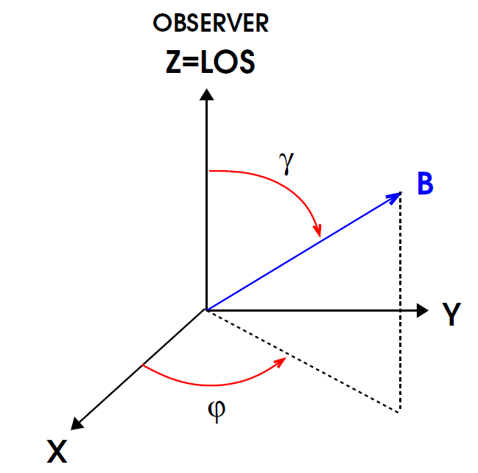
Polarized radiative transfer
Magnetic field - an anisotropy in plasma generating polarization of radiation
B - the magnetic field vector
- an azimuth of B
γ - an inclination of B

Slide 27
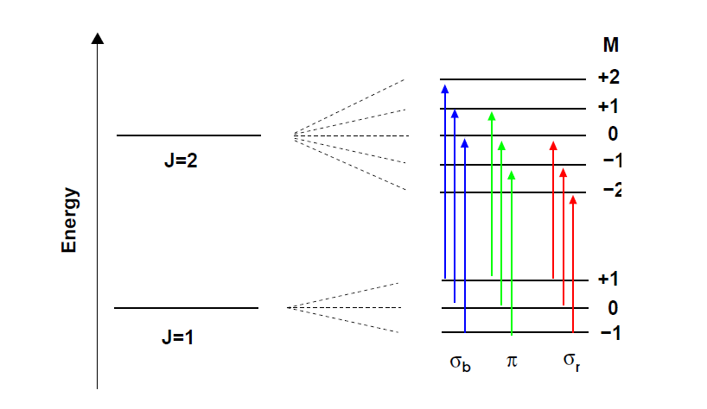
Zeeman splitting of levels

Slide 29
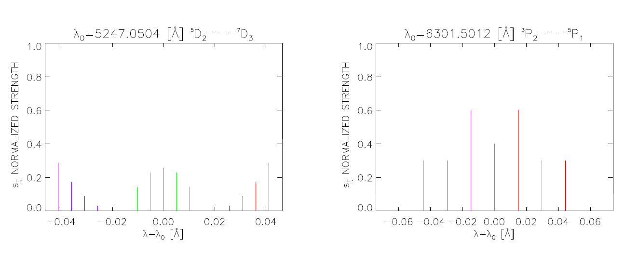
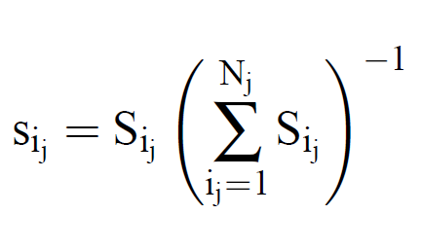
Zeeman splitting of levels and lines

Slide 30
Polarized radiative transfer
Radiative transfer equation
for radiation propagating along z axis
in vector form
where I(z) is the Stokes vector I = (I, Q, U, V)
is the absorption matrix
S(z) is the source function

Slide 31
Polarized radiative transfer
Radiative transfer equation in LTE
S(z) = (B, 0, 0, 0), where B is the Planck function
in matrix form

Slide 32
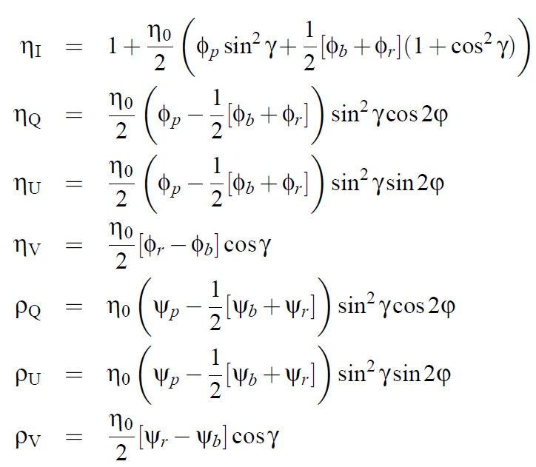
Elements of the absorption matrix
η₀ the ratio of the line and continuum absorption coefficients
Φ_{j} the absorption profile (j = r, p, b)
Ψ_{j} the anomalous dispersion profile
the azimuth of the magnetic field vector
γ the inclination of the magnetic field vector

Slide 33
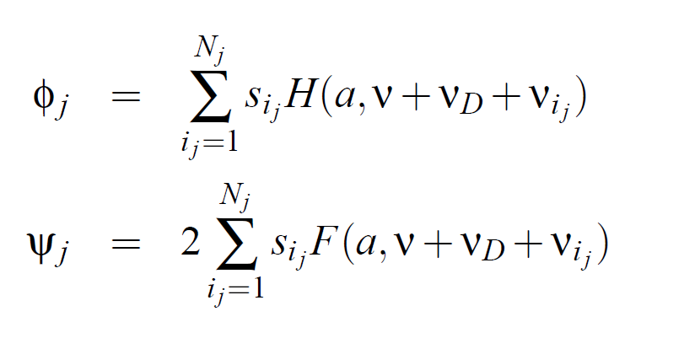
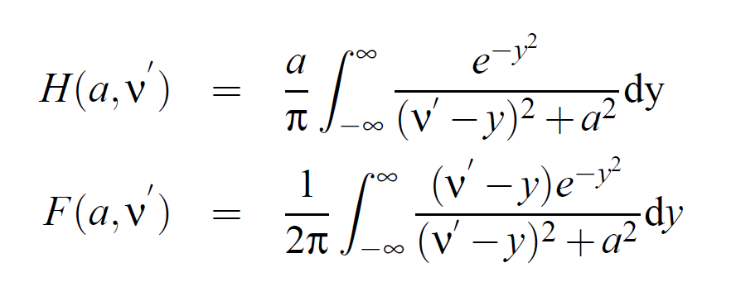
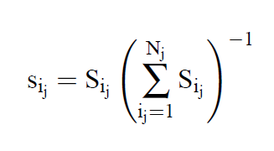
Absorption and anomalous dispersion profiles
Voigt function
Faraday function
Normalized strength of a component

Slide 34
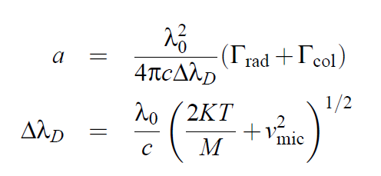
Absorption and anomalous dispersion profiles
wavelength shift of Zeeman components
Landé factor

Slide 35
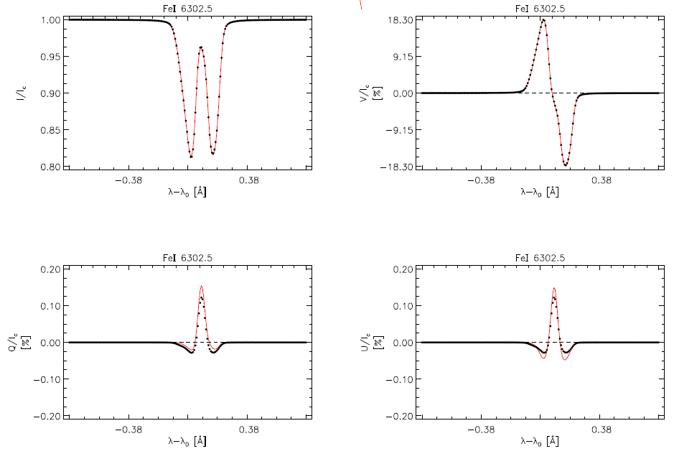

Slide 36
Sources and credits
https://www.slideshare.net/solohermelin/polarization-43121045
http://emanim.szialab.org/

